Slide 1
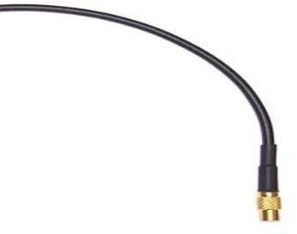
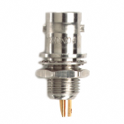
To amplifier and MCA
Digital pressure gauge
Bypass Valve
760.2mm
Main Pumping Valve
To DAQ controlled hardware
²⁴¹Am
and Si detector
p₀
Output pressure gauge
Hi pressure gauge
Solenoid controlled valve
Needle valve
Pressure controller
Output valve
Mechanical pump
Hi pressure valve
Output pressure control valve
α-range experiment
setup
Ar, N₂ or He gas high pressure cylinder

